Slide 1
Increasing access and value of Self-Care in Africa
Dr Padmaja Kamath
Director, Regulatory & Scientific Affairs
Global-Self Care Federation

Slide 2

Who we are
The Global Self-Care Federation represents associations and manufacturers in the self-care industry and is committed to promoting sustainable growth and better global health outcomes for all.
As a go-to source of self-care information for all healthcare professionals. We work closely with our members and relevant stakeholder groups to help them deliver better choice, better care and better value.
Contributing to WHO's public health goals as an NGO in official relations with WHO since 1977.

Slide 3

Defining Self-Care
Self-care refers to the holistic activities, practices, and products—both medicinal, devices, and nutritive—that a person can adopt to improve their health and well-being. Self-care involves:
Making healthy lifestyle choices
Avoiding unhealthy lifestyle habits
Making responsible use of prescription and non-prescription medicines
Self-recognition of symptoms
Self-monitoring
Self-management
“The ability of individuals, families and communities to promote health, prevent disease, maintain health, and cope with illness and disability with or without the support of a health-care provider ”
- WHO working definition¹
1 – https://www.who.int/reproductivehealth/self-care-interventions/questions-answers-self-care.pdf?ua=1 (June 2019)
Notes:
Practical examples:
Self screening, self sampling, self diagnosis – e.g Breast self check, HPV self sampling
Self-testing: HIV self-testing
Self-administration – injection with insultin, heparin
Self- monitoring – glucose and BP monitoring

Slide 4
Benefits of Self-Care
Self-care provides individuals, families and communities with the ability to manage their health and prevent disease with or without the support of a health-care provider in a responsible manner.
For Individuals
For Healthcare Systems
Greater choice of healthcare options and more accessible entries to care (e.g. through pharmacies)
Greater value for care when treating mild ailments and chronic conditions
Can lead to long-term better health outcomes
Education and informed choices based on evidence provided by digital tools and pharmacists/nurses
Eases the burden on healthcare systems and professional medical personnel
Increased freedom for innovation in healthcare
Improved progress toward universal health coverage

Slide 5
Future of Self-Care
Changing Landscape
The rapid evolution of technology is transforming the delivery of healthcare
Key goals:
1. Tech & digital healthcare
2. Pharmacist as core HCP
Individual empowerment
Self-care enables individuals to become informed and active self-managers of their own health care
Key goals:
1. Telemedicine
2. Self-care literacy
Self-care and Universal health care
Integrate self-care as a building block of UHC, to deliver improved quality of care and better health outcomes
Key goals:
1. Showcase the value – economic & social
2. Health promotion
3. NCDs
Global knowledge transfer for Better Global Health supported by international coordination and solidarity
Notes:
Changing landscape: Self-administered care, with guidance from remote digital consultations will play a key role
Estimated shortage of 12.9 million healthcare workers by 2035⁴
Estimated 1 in 5 of the world’s population now live in humanitarian crises⁴
^{Individual empowerment}
In US, primary care physicians estimate that 10% of visits could be avoided by the use of OTC medications5
92% of physicians agree that OTC medications are effective and appropriate for first-line treatments
A study in Scotland for found >13% of GP visits were suitable for management in community pharmacies⁶
^{Self-care and UHC}
Focus on health promotion and prevention as core priorities of UHC, to help move the healthcare system from disease management to disease prevention
Increase investment in self-care and treatment for NCDs, to remove the heavy burden placed on healthcare systems and create long-term savings for healthcare systems

Slide 6

Future of Self-Care in Africa
Prominent role for pharmacists
Effective Regulatory framework supporting self-care
Digital technologies
Key Pillars for success

Slide 7

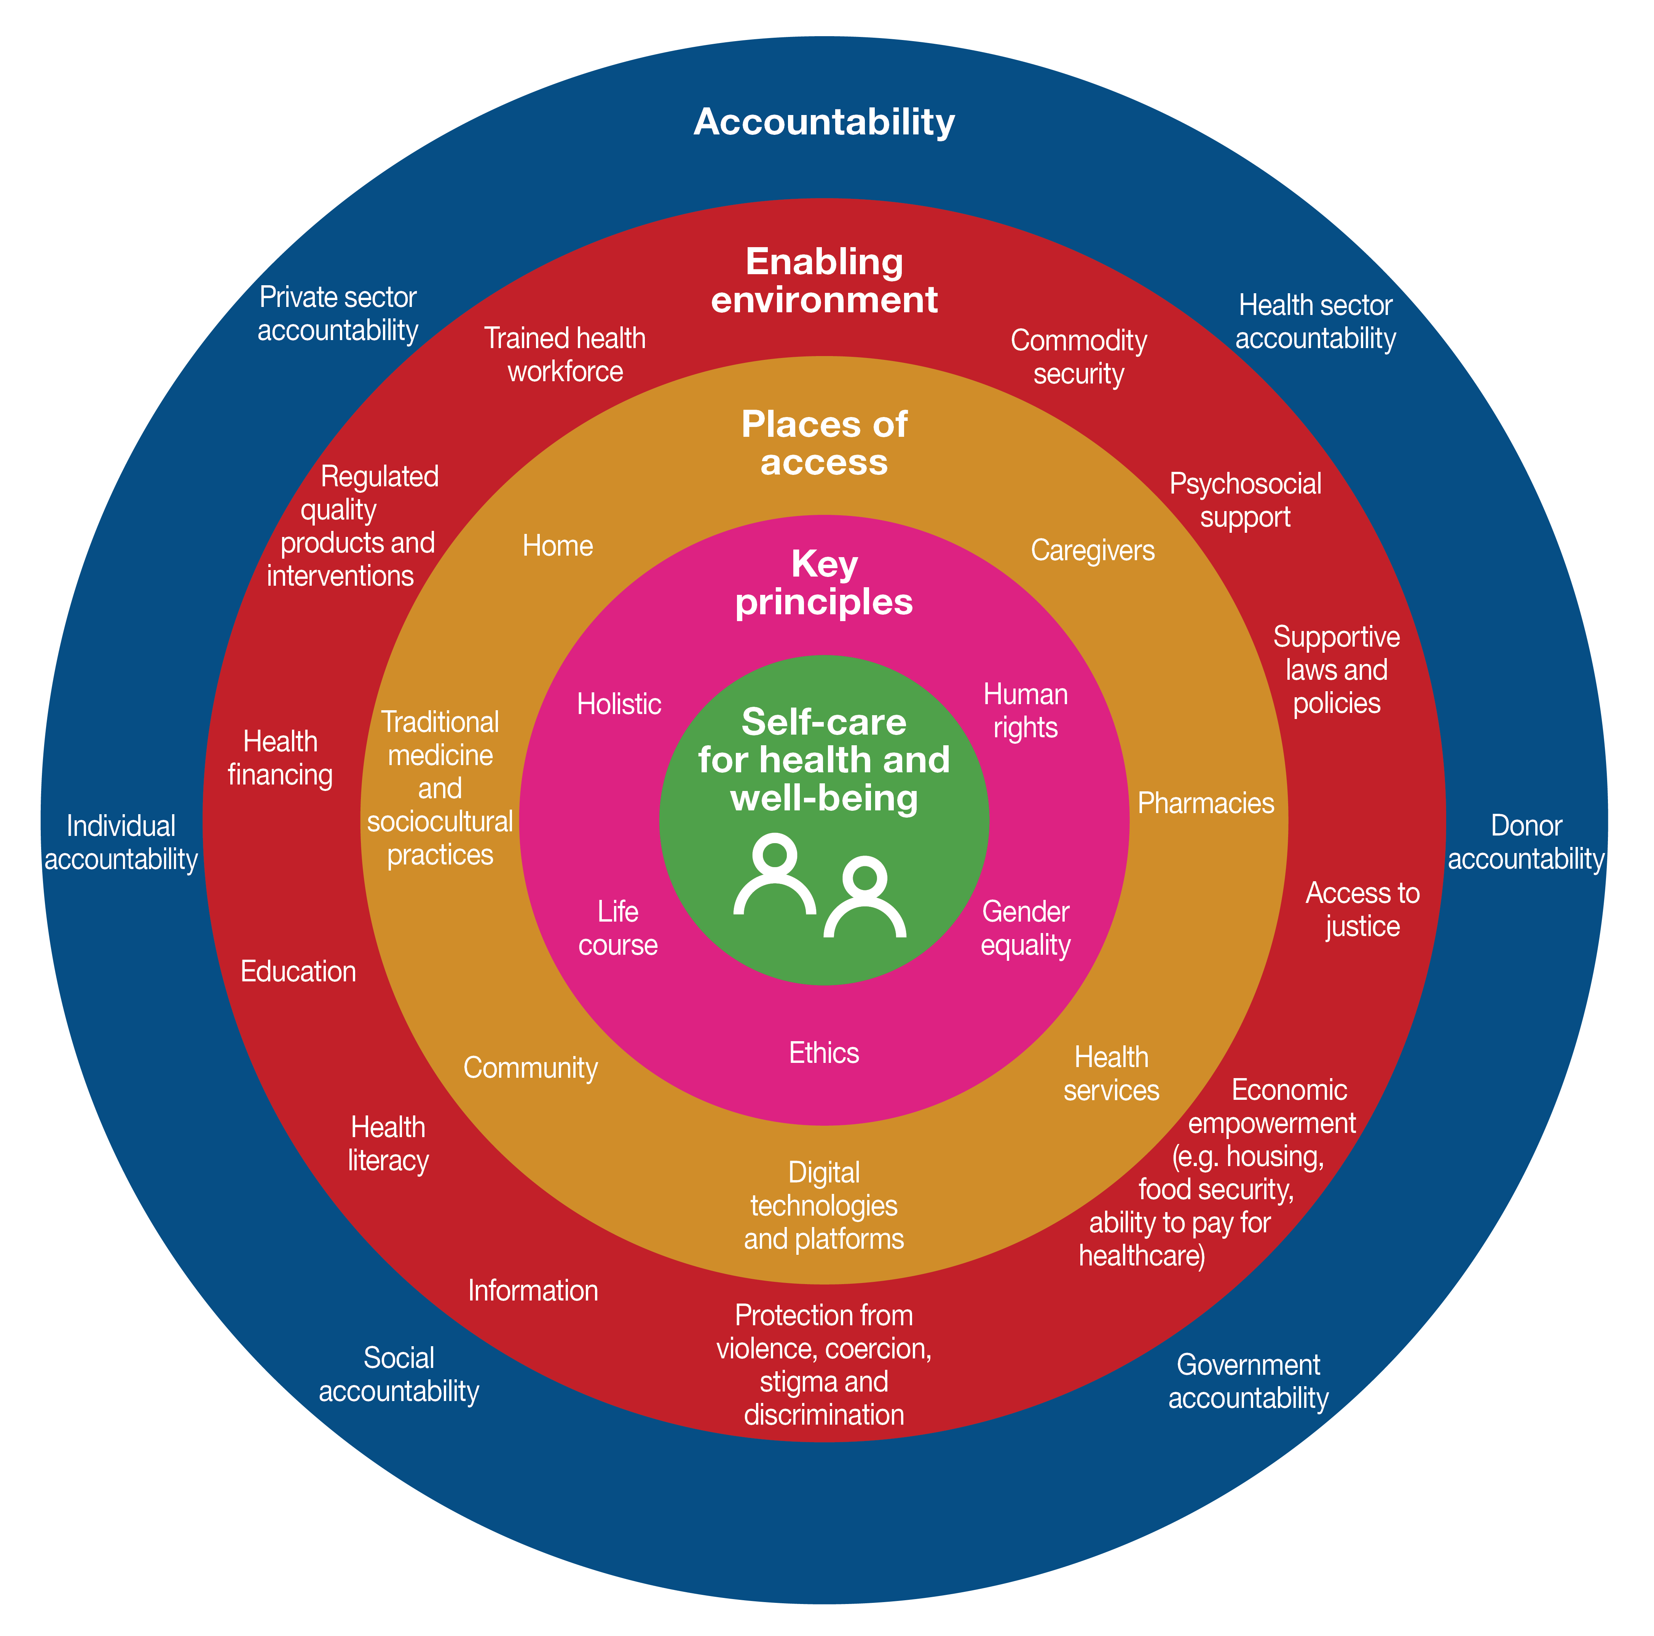

Pharmacists in prominent role
Pharmacists
Typically a patient’s first point of contact with the healthcare system
Review → Prescribe → Dispense → Administer
Capable of modifying prescriptions and dispense alternative medicines without consulting a doctor to ensure the continuity of treatment
Evolving roles include educating patients and providing primary care to patients
Offer drive-through services, telemedicine and medication deliveries to ensure the continuation of patient treatment
Stock appropriate products and promote disease prevention
Self-care conceptual Framework²
FIP – GSCF Joint Statement of Policy on Responsible and Effective Self-care
2 – Adapted from Narasimhan M, Allotey P, Hardon A : Self care interventions to advance health and wellbeing: a conceptual framework to inform normative guidance. Bmj 2019;365 l688
Notes:
All actors in the healthcare system, including nurses and pharmacists, play an important role in self-care, which was particularly evident in the initial COVID-19 response.
Pharmacists also offer 1st level primary care support in some cases - we have seen more and more pharmacist play a role in vaccination programmes, community education programmes with HIV, TB, malaria.

Slide 8
Digital solutions as self-care enablers
Managing Health
Mobile Health
Remote monitoring apps
Global trend – increased interest in self-care
WHO and AU strategy
Digital transformation – key strategic pillar of AU
Limited legacy challenges
Increasing access
eCommerce
end to end Supply Chain
Assisting Consumer Education
Health Literacy apps
eLeaflet
Enabling Communication
Fast information tools e.g. during pandemic
Notes:
Global trend of growing interest in self-care, driven by increased use of digital technologies exacerbated by COV-19 pandemic
WHO and AU strategy: Focuses on accelerating the development and adoption of appropriate, accessible, affordable, scalable and sustainable person-centric digital health solutions
To prevent, detect and respond to epidemics and pandemics
Develop infrastructure & applications to enable countries to use health data to promote health and wellbeing

Slide 9
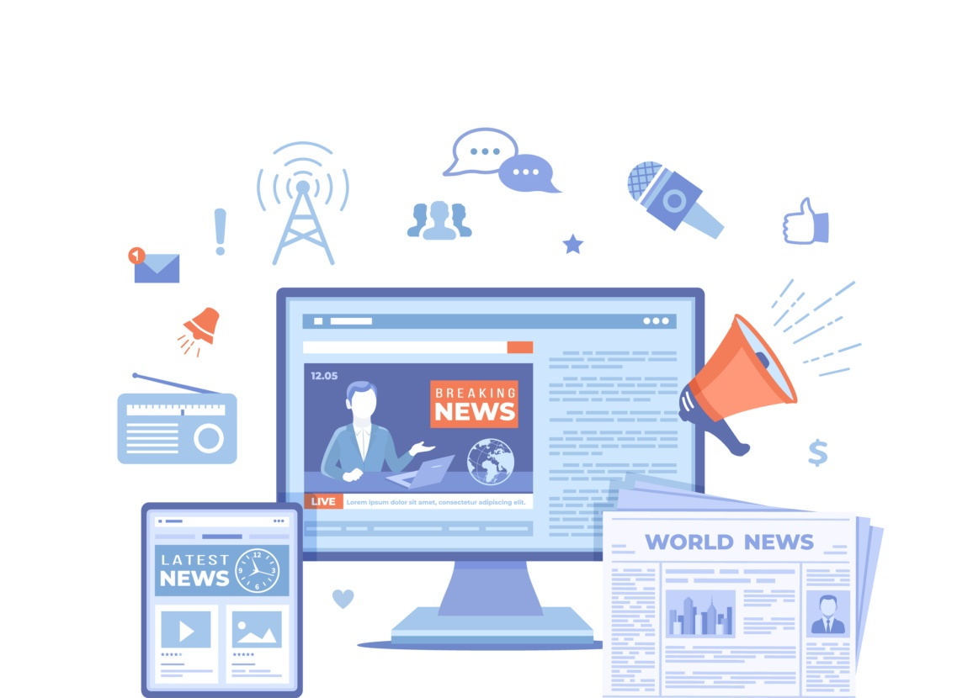
Role of digital technologies during the pandemic
Enabling communication
Acceleration of use of digital technologies for information purposes
Pandemic convinced governments and societies to turn towards digital technologies to assist in combating the growing crisis
Increasingly requiring governments to use digital communications to channel reliable COVID-19 information
Africa has leveraged digital solutions in generating low-cost COVID-19 testing kits, 3D-printed ventilators and critical self-care messages to solve problems around access to healthcare.
A review of the national portals of the 193 United Nations Member States demonstrated that by 8 April 2020, approximately 86% (167 countries) have included information and guidance about COVID-19 on their respective digital portals. https://www.un.org/fr/desa/digital-technologies-critical-facing-covid-19-pandemic

Slide 10
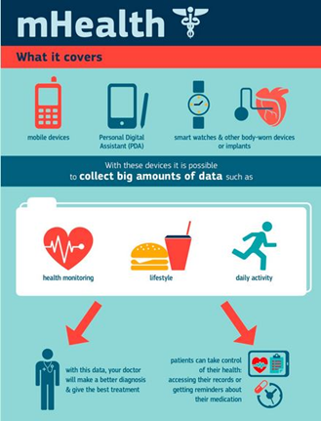
Digital technologies to manage own health
Managing health
Fast growth of “apps”
In 2017: 325,000 health applications available worldwide:
Individuals can actively monitor their own health.
Increase in evidence that health apps could have a positive impact on diet monitoring, physical activity or medication adherence.
PAGB_Self_Care_and_Tech_Aug2019.pdf
mHealth initiative as part of shaping Europe’s digital future:
To empower patients and consumers to manage their health more actively, live more independently thanks to self-assessment or remote monitoring solutions.
mHealth can also support healthcare professionals in treating patients more efficiently as mobile apps can encourage adherence to a healthy lifestyle.
A fully optimized mHealth environment can contribute to modern, efficient and sustainable health system.
mHealth | Shaping Europe’s digital future (europa.eu)

Slide 11
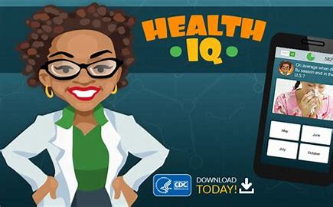
Education through digital technologies
Assisting Consumer Education
Consumers must be able to access reliable and trusted disease and product information
Web portals and apps with clear, accurate and trusted information can help individuals feel more confident about responsibly self-managing minor ailments.
Interactive solutions such as gamification can help individuals gain more knowledge on self-care and improve health literacy e.g. the U.S. Center for Disease Control and Prevention (CDC) developed an app “Health IQ”, trivia-based tool that can help users improve their health literacy.
eLeaflet: some countries allow QR Codes and NFC chips to direct people to an OTC medicine’s patient information leaflet. In the future this could also be used to provide broader information, including instructional videos, to help empower people to self-care.

Slide 12
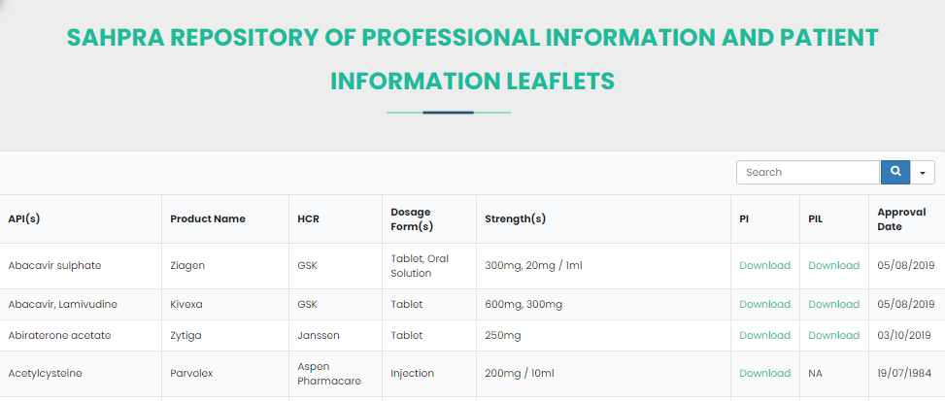
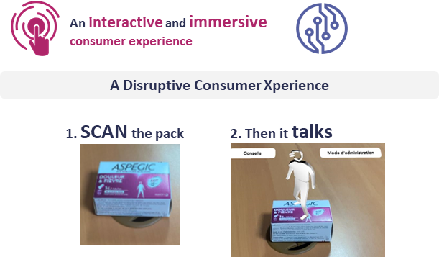

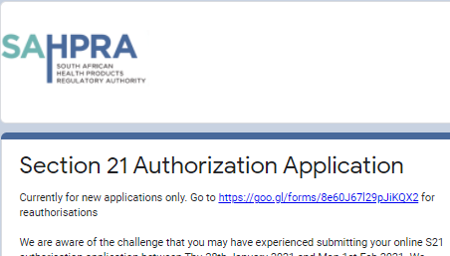
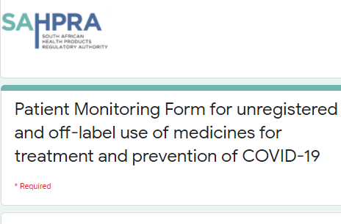

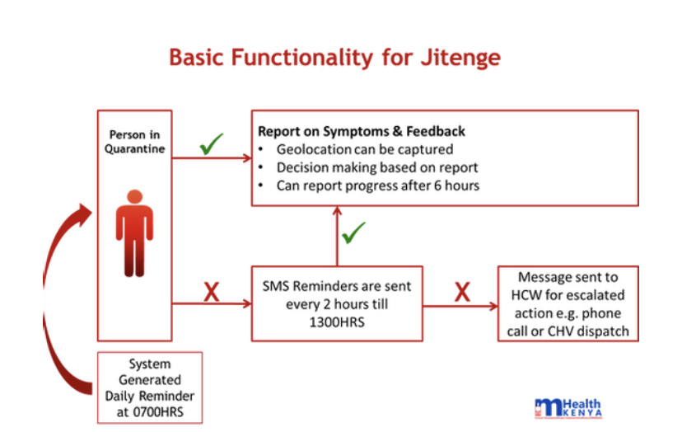
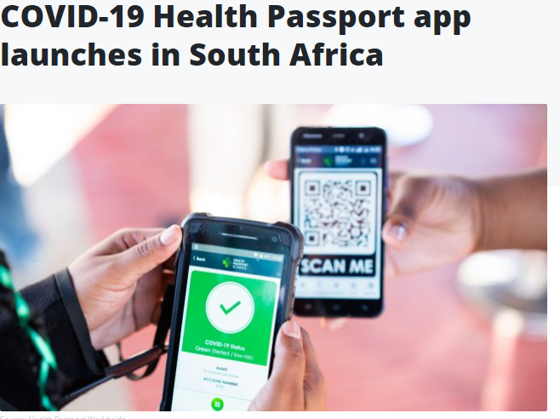

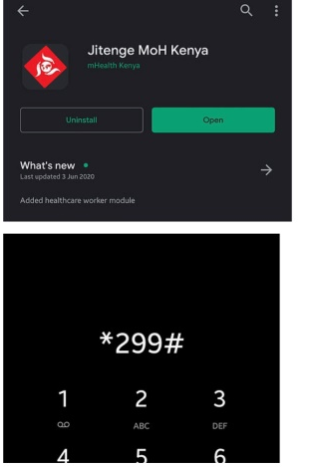
Education through digital technologies
Assisting Consumer Education
Examples from Africa

Slide 13
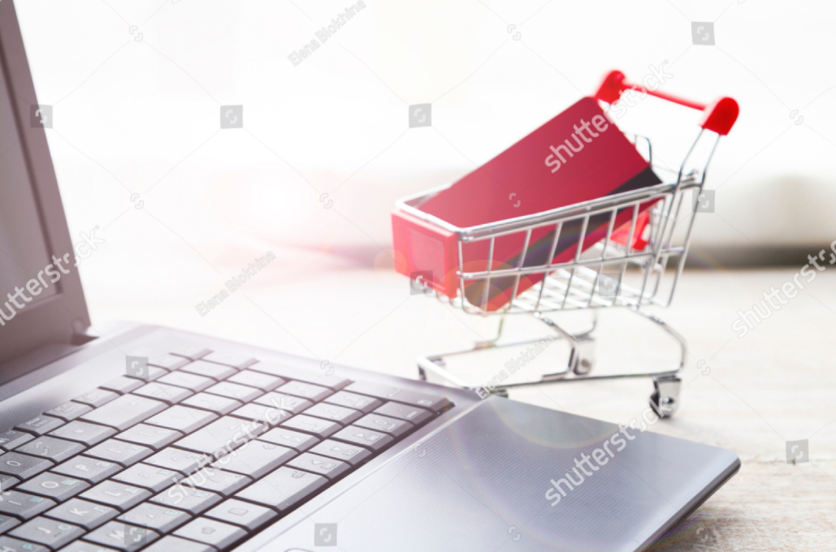
Increasing access to quality OTC products
Facilitating access
eCommerce boom
eCommerce regulations evolving rapidly e.g.
Russia regulatory framework changes accelerated due to the COVID-19 pandemic, now allowing online sale of OTC medicines by pharmacies.
EU Commission stressed that "in order to allow for electronic commerce operators to reap the full benefits of the Single Market, it is essential to avoid regulatory inconsistencies and to ensure a coherent legal and regulatory framework for electronic commerce".
Digital technologies facilitating end-to-end supply chain to provide access to quality medicines and self-care products.
The onset of the global pandemic has accelerated the shift in consumer shopping behavior as online shopping offers a safer option from a social distancing or contact perspective, relative to their health. https://themediaonline.co.za/2020/05/covid-19-fastracks-online-shopping-in-south-africa/

Slide 14
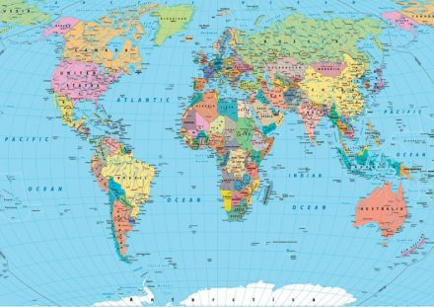
Global Status of OTC e-commerce
Facilitating access
Regulatory diversity
Allowed through any retail platform e.g. USA, Singapore
Allowed only through online pharmacies e.g. India, Japan, Russia
Prohibited e.g. South Korea
Combination of both e.g. in UK, Australia, South Africa: GSL medicines allowed through any authorised retail outlet and Pharmacy-only medicines allowed through online pharmacies only.

Slide 15
Effective Regulatory Framework that supports Self-Care – Key Enabler
Policies and legislative provisions supporting self-care products
Accessibility & Manufacturing
Advertising & promotion
Defined scheduling criteria/classification
Minimum effective regulations for self-care products
Africa Monograph application to enable faster registrations
Regulatory reliance models - faster release to the markets
Africa free trade principles
Harmonization between AU Member states
Advertising to consumers – raise awareness
Additional points of sales
Digital marketing
Notes:
- Accessibility & Manufacturing :
Regulatory reliance models to accelerate faster release of Self-Care products to the markets
Africa free trade principles allowing products to be manufactured in any AU country to be registered in others
Harmonization between AU Member states for OTC scheduling to reduce consumer access disparities
- Advertising & promotion:
Advertising to consumers - OTC products face restricted communication to consumers due to uneven regulations currently in place in various countries.If AWARENESS is raised it could alleviate the burden placed in healthcare providers
Point of Sale : In most African markets, self-care products are sold only through pharmacies . Option for a GSL line is not permitted, although this would increase easy access and awareness on OTC products
Digital marketing : As Africa moves toward a technologically advanced state regulation, endorsing Digital Advertising could be beneficial

Slide 16


Slide 17
THANK YOU
pkamath@selfcarefederation.org

