Slide 1
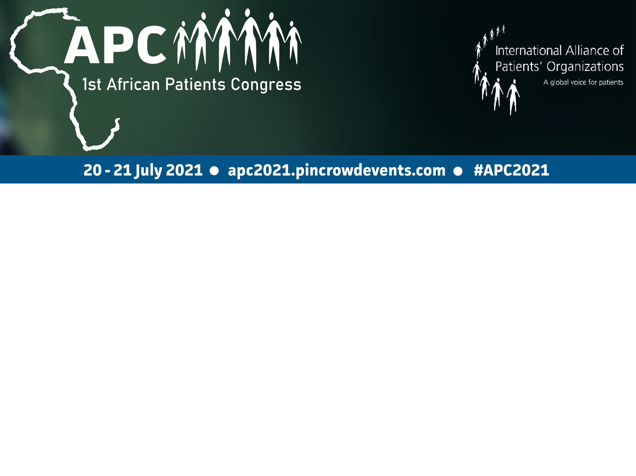
Have the big 4 NCD (CVD, Cancer, Diabetes, COPD) vertical programmes overshadowed other NCDs in Africa
Lefate Makunyane
South African Depression and Anxiety Group

Slide 2

SADAG – Mental Health Matters
Phone counselling & referral – 25 lines (24 hour Helpline):
1400 calls p/d (63% rise)
Suicide calls – 65 475 in 8 months
Patients Rights Advocacy – Mental Health Act / Life Esidimeni
Social Media - 27 674 patients in 8 months
Rural Counselling Container
Speaking Books – low literacy / terminally ill patients
Media & Press – over R 75,5 million worth

Slide 3
Current challenges
Funding Priorities (Gov/global agencies)
HealthCare System – Burden
COVID pandemic v/s group of NCD’s (including mental health)

Slide 4
Conclusion
NSP NCDs 2021 – 2026 (Health In All Policies)
Africa CDC – strengthening health systems
Corporate Partnerships – SADAG lessons
Community – Upstream Integrated Health

Slide 5

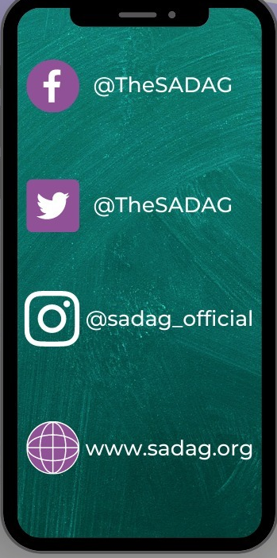
Thank you!
SADAG Office 011 234 4837
SMS 31393
WhatsApp Line 076 88 22 775

