Slide 1
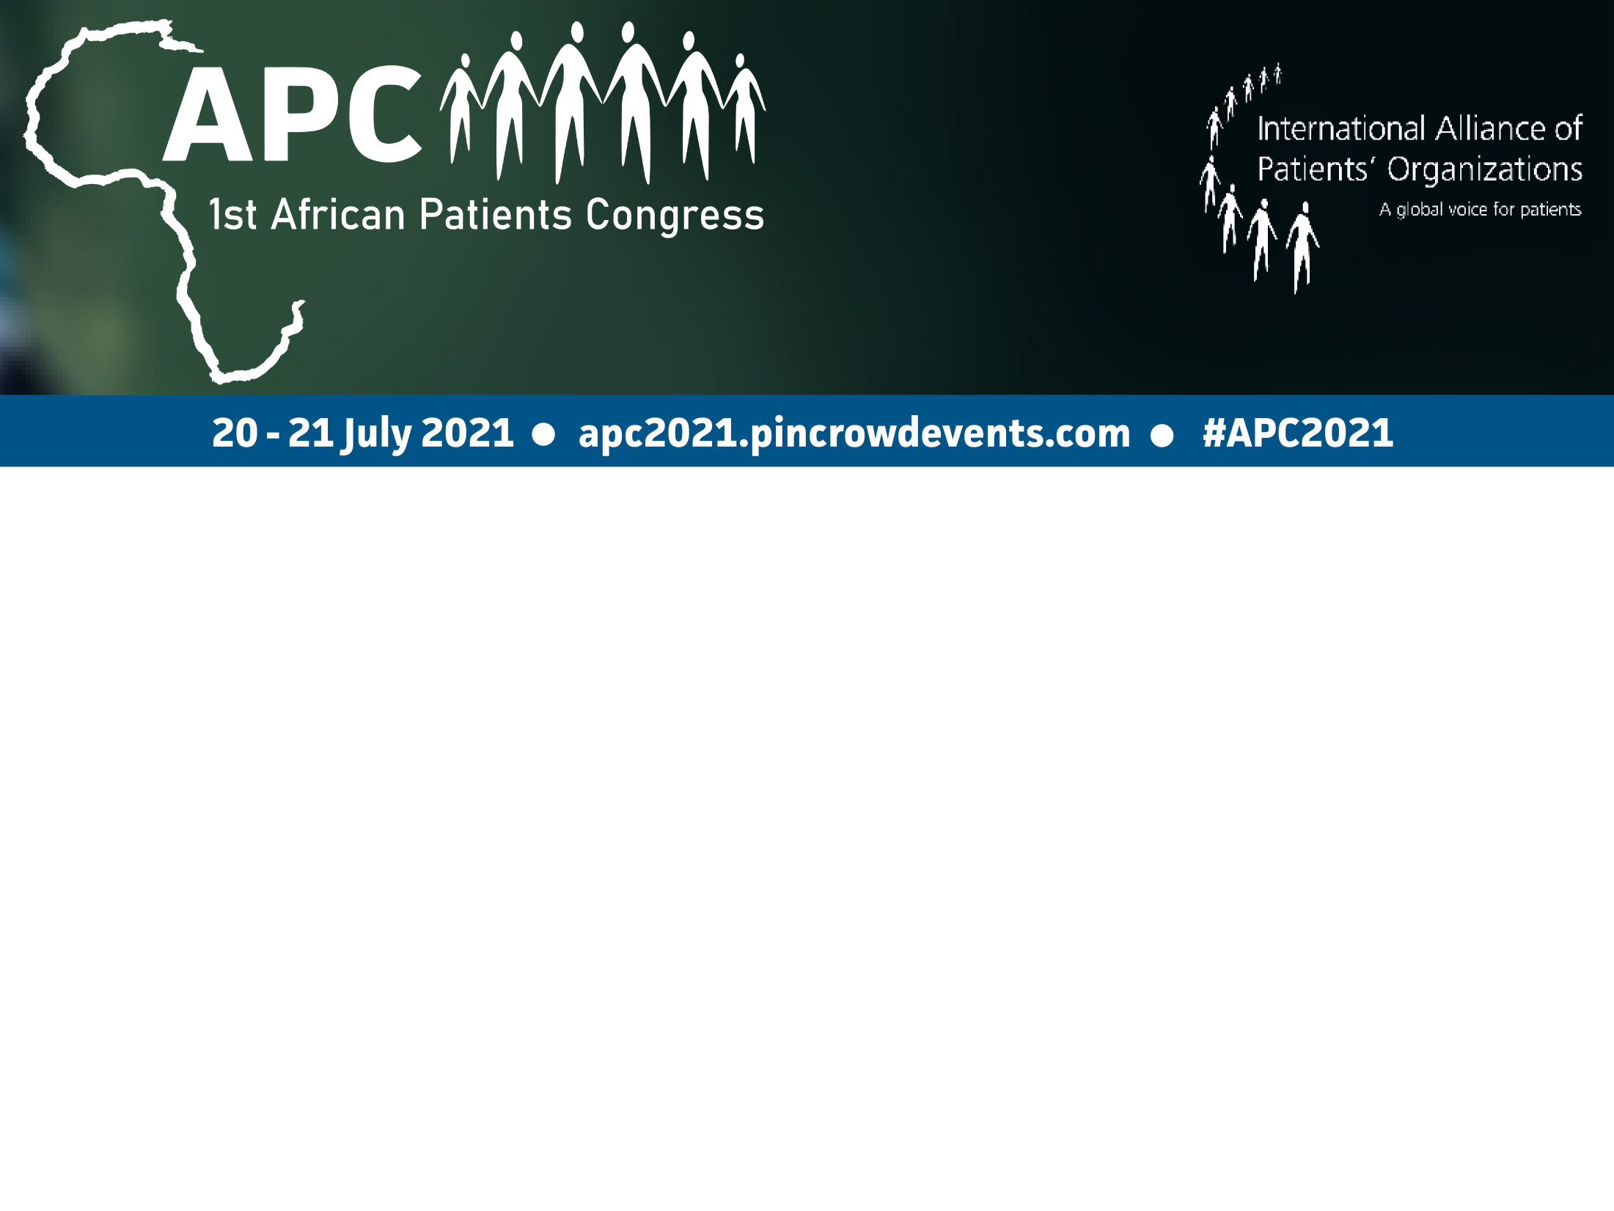
Regulatory reliance and benefits to African patients
DELESE DARKO (MRS)
CEO, Food and Drugs Authority, Ghana

Slide 2

Presentation outline
Regulatory approval pathways
Reliance- overview
Reliance mechanism at global level
Reliance mechanism at regional level
The case of the African Vaccines Regulatory Forum

Slide 3
INTRODUCTION
National Regulatory Authorities (NRAs) ensure that medicines are of good quality, safe and efficacious and also correctly promoted for the benefit of patients.
All NRAs have in place regulatory guidance and procedures for review of medicinal products.
Regulatory review pathways may involve full review, reliance and collaboration based on well-defined regulatory processes.

Slide 4
RELIANCE
Allows formally/informally, an NRA to use abridged assessments/lab/GMP reports made by other NRAs or trusted body, while remaining responsible for the final decision
Benefits
Timely access to quality-assured, safe, and effective medicines
Facilitate availability of complex therapies
Allow efficient use of resources - concentrate on other areas of regulation e.g. post market surveillance for quality and safety
Eliminate of duplication of efforts; building regulatory capacity and trust

Slide 5
RELIANCE MECHANISMS AT GLOBAL LEVEL
Collaborative procedure
  Swissmedic Marketing Authorisation for Global Health Products (MAGHP) procedure
  WHO
Access to Shared Reports
  WHO Public Assessment Reports (WHOPAR)
  WHO Public Inspection Reports (WHOPIR)
  European Public Assessment Reports (EPAR)
WHO-SRA Pilot Project (PH products)

Slide 6
RELIANCE MECHANISMS AT REGIONAL LEVEL
African Medicines Regulatory Harmonization
    EAC- East African Community- 6 countries- 150million population
    West African Health Organization (WAHO)- 15 countries- 185million
    Zazibona- 4 countries- 34million
    SADC- South African Development Community- 16 countries- 300million
  African Vaccines Regulatory Forum (AVAREF)

Slide 7
AFRICAN VACCINES REGULATORY FORUM
AVAREF

Slide 8
Objective
  Informal capacity-building platform of NRAs & Ethics
  To improve regulatory oversight of interventional clinical trials conducted in Africa.
Success
  Strengthened regulatory and ethics reviews & oversight
  Promoted harmonized standards and approaches
  Accelerated review of vaccines of public health value
Notes:
Created in 2006 by the WHO
New Governance in 2016
Alignment with AMRH-AMA in 2019

Slide 9
AMRH GOVERNANCE STRUCTURE 2019
African Medicines Regulators Conference (AMRC)
ASSEMBLY
LIGHT BLUE = TWG Not yet established
DARK BLUE = JAG Not yet established
MEDIUM BLUE = TWG Functional
INDIGO = JAG
Established
AUC-NEPAD-WHO JOINT SECRETARIAT
AMRH Steering Committee
Representing the 8 RECs of the AU
CONTINENTAL TECHNICAL WORKING GROUPS (TWGs)
MA & Registration
AMQF
AVAREF
ABRF
RCD + Policy & Regulatory Reforms
PAHWP
GMP
APAG
AMRH PARTNERSHIP PLATFORM
Regulatory Systems
NEPAD-WHO JOINT SECRETARIAT
TBD
Mkt Surveillance & Control + Lab Access & Testing
CLINICAL TRIALS & OVERSIGHT
Blood & Blood Products
Medical Devices
GMP/Regulatory Inspections
Vigilance
JOINT ACTION GROUPS (JAGs)
Comprising of Members of & Observers to the AMRH Partnership Platform

Slide 10

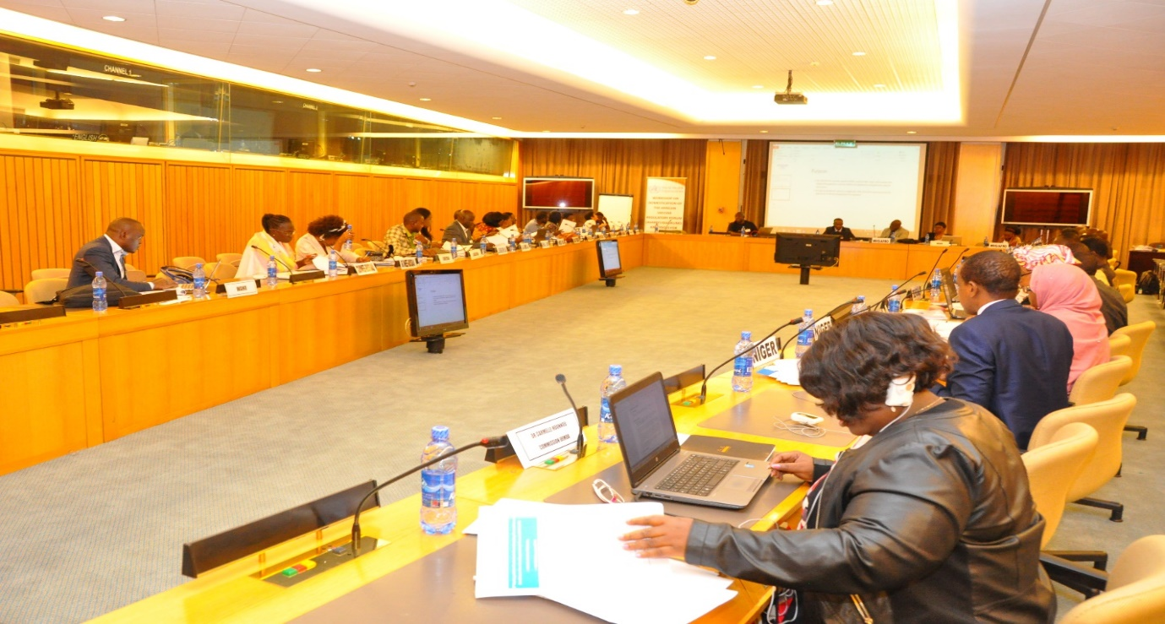
Implementation and domestication of AVAREF documents as part of AMRH (2)
  WAHO: 25 to 27 February 2019
Notes:
The harmonized templates will be tabled at the next AVAREF’s Assembly for adoption on 2 October 2019
The purpose is to have all the 55 African member states adopt and incorporate them into their battery of tools
Use of the templates for all future joint reviews of clinical trial applications coordinated by AVAREF

Slide 11
Benefits to patients in Africa – Access during PANDEMICS
Ebola Virus Disease
  Countries worked together to ensure a vaccine was available
  The Merck Ebola Vaccine (ERVEBO) is now fully registered in several African countries as well as EU and USA and was used during the 2019 and 2020 outbreaks in DRC and the 2021 outbreak in Guinea Conakry
Sars-Cov-2 Disease (Covid-19)
  Reliance used for Emergency Use Authorization of vaccines
  These included Moderna, AstraZeneca-Oxford University Covishield, Pfizer-BioNTech and Johnson and Johnson
  Some of these vaccines are being distributed under the COVAX scheme

Slide 12
Reliance: Access during EPIDEMICS
There are seasonal outbreaks of meningococcal disease in the Meningitis Belt in West Africa – mostly the Sahel Regions
Serum Institute of India Ltd - Meningococcal A vaccine (MenAfriVac A) developed to deal with the outbreak in 2011
MenAfriVac A obtained accelerated regulatory approval for use in several countries through AVAREF Joint Review
Individual countries then gave authorization for use of MenAfriVac A in identified population groups
Inspired Hope for a Future without Meningitis

Slide 13
Reliance : ENDEMIC DISEASES
GSK Mosquirix malaria vaccine – AVAREF joint review following Positive Scientific Opinion by the EMA under Article 58
Ghana, Kenya and Malawi have since 2019 been undertaking the Malaria Vaccine Implementation Programme
Data on effectiveness, safety etc. are pooled and a final recommendation from WHO is expected in 2022 or 2023
Collaborative working by African Regulators is speeding up the rigorous assessment and evaluation of the malaria vaccine prior to recommendation for widespread use thereby benefiting African patients

Slide 14
Reliance: PRODUCT SAFETY MONITORING
The AU-3S Programme is a continental initiative led by the African Union (AUDA/NEPAD) to pool together safety data to permit early detection of safety signals in relation to medical products
The specific objectives of the AU’s “Smart Safety Surveillance” Programme include:
  Improving medicines and vaccine safety for patients in Africa and globally and enabling African ownership and ability to act on African data
  Increasing confidence in accelerated product development and in an emergency response
These outcomes can only be possible through collaborative working together and sharing of data among member states

Slide 15
Conclusion
Regulatory Reliance provides benefits to African patients through accelerated access to products for pandemics, epidemics and for diseases which are endemic in Africa
Through regulatory reliance and the mechanisms there have been accelerated access to vaccines and medical products
Collaborative working is also improving Africa’s capacity to quickly identify safety signals in relation to medical products thereby protecting African patients

Slide 16

Thank you!

